Slide 1
PHOTO DEDUPLICATOR
GROUP A

Slide 2
Contoso was great to work with. Patrice was my representative and she anticipated my needs and worked diligently to fix my issue.

Slide 3
Agenda
01. Project methodology
02. Implementation team
We will discuss pros and cons of waterfall and agile methodologies. And give our reasons for chosen methodology.
We will discuss three job roles essential to the implementation team to cover all aspect of the delivery
03. Project Plan
04. Prototype
05. Testing & Deployment
We will show job roles and responsibilities for each job role throughout each of the development stages.
We will discuss specific features and business objectives.
We will show our protype and code while explaining the good coding practices used.
We will show tests completed and explain how this project can be deployed.

Slide 4
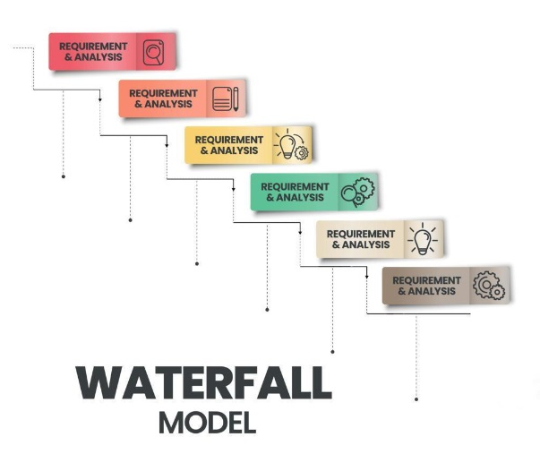
METHODOLOGIES
WATERFALL
PROS:
Clear structure with defined phases makes it easy to understand and manage each stage .
More accurate projection of time & cost.
Easier to manage and efficient as it has well-defined requirements that will not change.
Each step is well documented ensuring that all team members are on the same page and requirements are clear.
CONS:
Less adaptable and can be costly if changes required
Testing late in the cycle could be costly if issues found
Feedback comes in late leading to significant rework if requirements were not clear
Due to sequential approach if any phase fails, it can jeopardize the project
Risks have to be identified and addressed during initial stages
Best suited for projects that have well defined requirements from start to finish. It is easy to manage however can lack flexibility. It gives predictability and structured documentation.

Slide 5
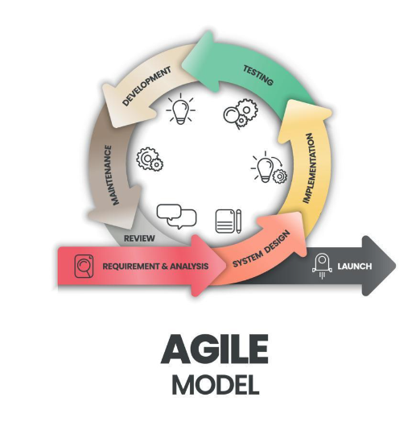
METHODOLOGIES
AGILE
PROS:
Flexible and adaptable allowing for changes even late in development.
Regular feedback allows users to ensure product meets their needs.
Offers better communication among team allowing for better problem solving.
Early testing reduces risk of major issues down the line.
After every cycle, teams engage and reflect on ways to enhance their efficiency.
CONS:
Could lead to scope creep - changes and additions could extend both timeline of project and costs.
Requires constant involvement from team members and customers which can be time- consuming.
Harder to predict timeline and costs to project that could lead to poor decision making.
Great for projects that may need to evolve and feedback is required throughout the process. It is flexible and can be continuously improved with fast delivery. It can suffer from scope creep.

Slide 6
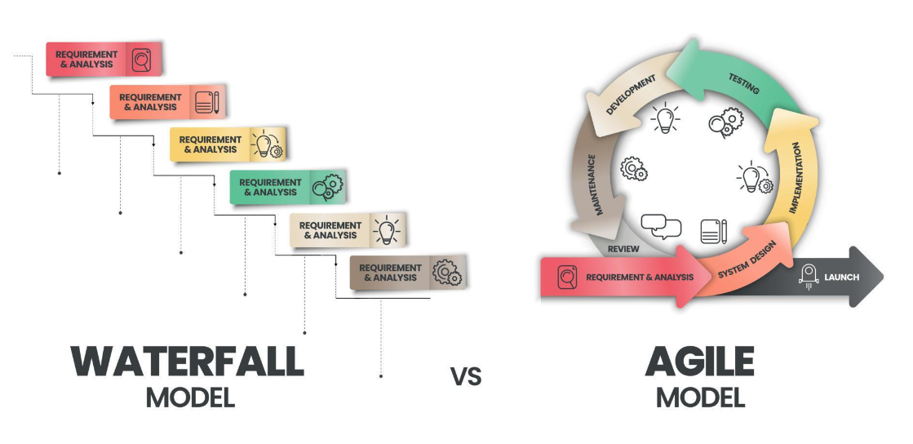
METHODOLOGIES
Our chosen methodology: AGILE
We have chosen Agile for Photo DeDuplicator project due to its flexibility and continuous feedback and earlier testing stages. It has also allowed us to make any required changes throughout the development and will allow for any evolving features in the future.

Slide 7
IMPLEMENTATION TEAM
Lead Developer
Product Owner
QA Engineer
Responsible for coding, integration and testing.
Ensures best coding practices and coding standards.
Manages development team, assigns tasks and ensures project meets requirements,
Acts as voice of the customer
Defines product requirements, and user stories.
Meets with other team members to ensure quality and functionality meets customers expectations
Responsible for quality and reliability
Designs and runs test plans, test cases and test scripts.
Ensures product meets the specified quality standards.

Slide 8
LEAD DEVELOPER
JOB DESCRIPTION
Proficiency in programming languages (e.g., HTML, Python, CSS).
Strong understanding of software development methodologies (e.g., Agile, Waterfall, Scrum).
Strong communication and interpersonal abilities
Problem-solving and critical-thinking skills.
Expertise in system architecture and design patterns.
Ensure adherence to best coding practices and standards
Design and develop high quality product
Collaborate with other team members/departments to define project requirements and deliver updates throughout the process
Fix bugs and issues when and if required
Create and update documentation to ensure it is up to date

Slide 9
PROJECT MANAGER
JOB DESCRIPTION
Strong understanding of software development methodologies and processes.
Proficient in using product management systems (JIRA, Trello)
Strong leadership and decision making skills.
Excellent communicator and analytical thinker.
Expertise in system architecture and design patterns.
Define product vision and strategy and ensure it aligns with business goals and objectives.
Create and manage product requirements and user stories
Gather requirements from stakeholders/customers and ensure it is well communicated throughout departments .
Attend review meetings and sprint planning meetings.
Collect user feedback and use it to improve product.

Slide 10
QA ENGINEER
JOB DESCRIPTION
Strong understanding of software development methodologies and processes.
Proficient in using product management systems (JIRA, Trello)
Detail-oriented with very strong analytical skills.
Excellent communication and collaboration abilities
Problem- solving and critical- thinking skills. design patterns.
Develop test plans and strategies. Define test objectives and criteria.
Write detailed test cases that cover all functional and non-functional requirements.
Execute manual tests to identify bugs and issues. Document and report findings.
Conduct performance, load and stress tests and report findings.
Perform regression testing to ensure code changes do not create new defects
Set up and maintain test environments

Slide 11
DEVELOPMENT STAGES

Slide 12
COMMITMENTS
FEATURES
BUSINESS OBJECTIVES
Application will have cross-platform compatibility- can be used with various operating systems Windows and macOS.
The application will support a wide range of formats such as .png , .jpeg and .gif. The application must recognise all formats and spot duplicate within a folder
The application will have a user friendly interface that is easy to understand no matter the skillset of the user.
The team will communicate clearly and have good time-keeping skills.
Saving storage space: the application will spot duplicate files so they can be deleted, freeing up storage space.
Regular bug fixes and improvements will be made.
Customer feedback will be implemented in the future to help improve the application.
The project must be cost effective without sacrificing quality or functionality.
The application should comply with relevant regulations regarding safeguarding, user data and security.
There should be security measures within the application to protect the users sensitive data and the user’s system
The application should be able to handle big workloads without any effects on the performance.

Slide 13
PROTOTYPE

Slide 14
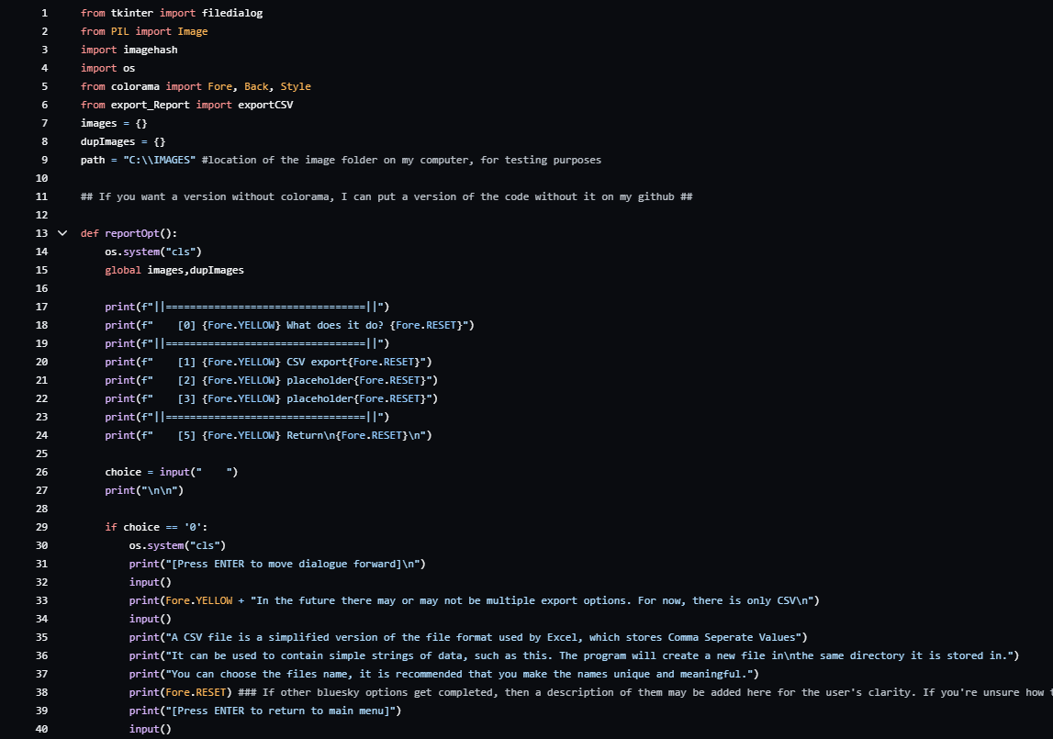
CODE

Slide 15
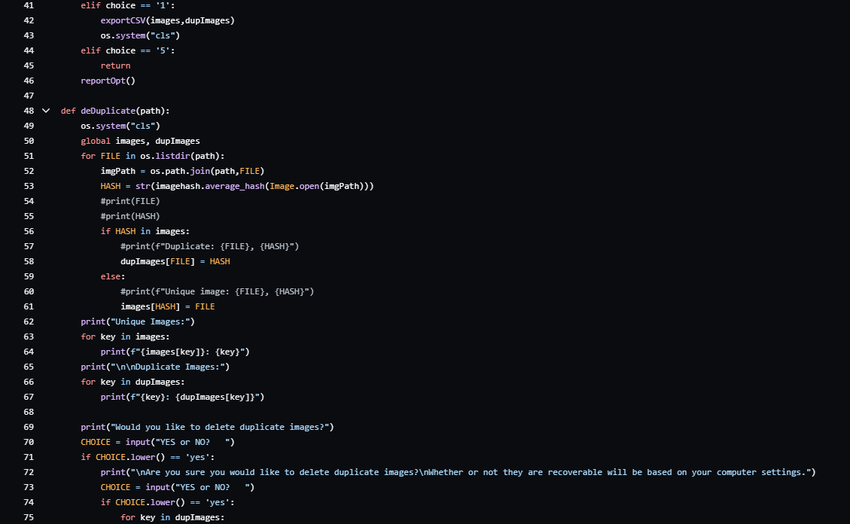
CODE

Slide 16
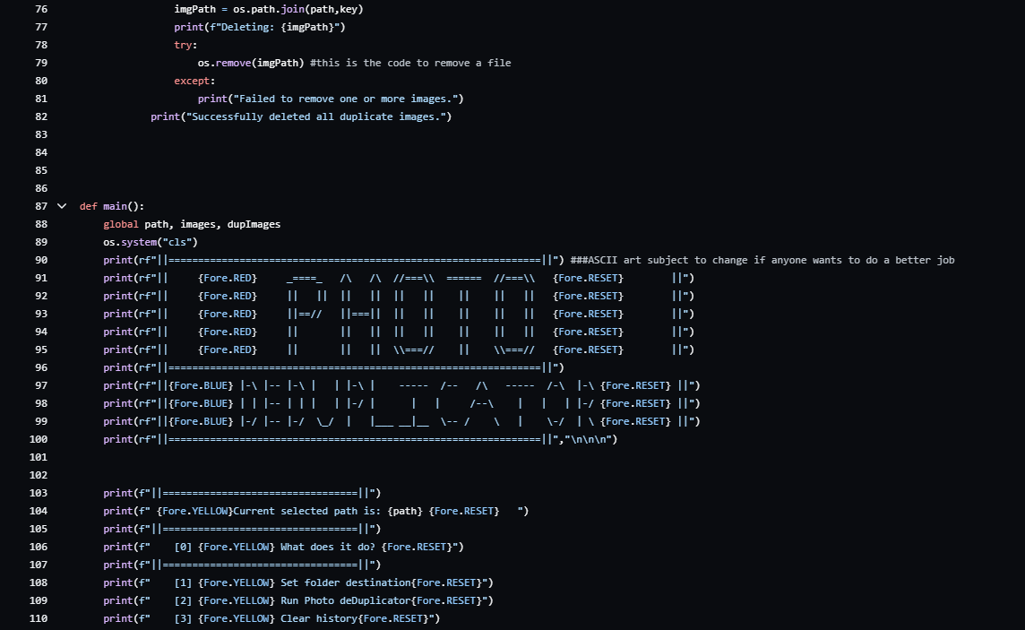
CODE

Slide 17
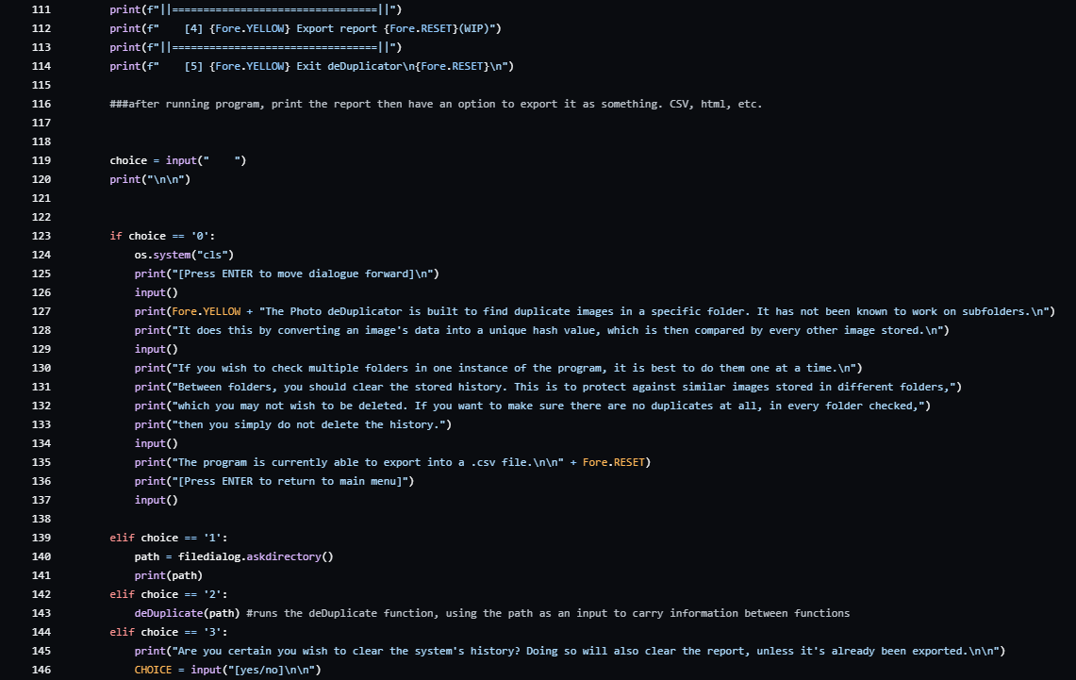
CODE

Slide 18
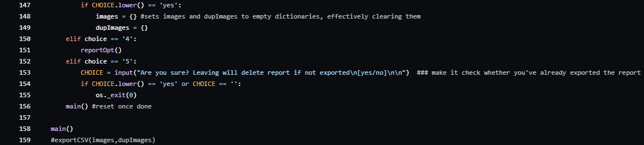
CODE

Slide 19
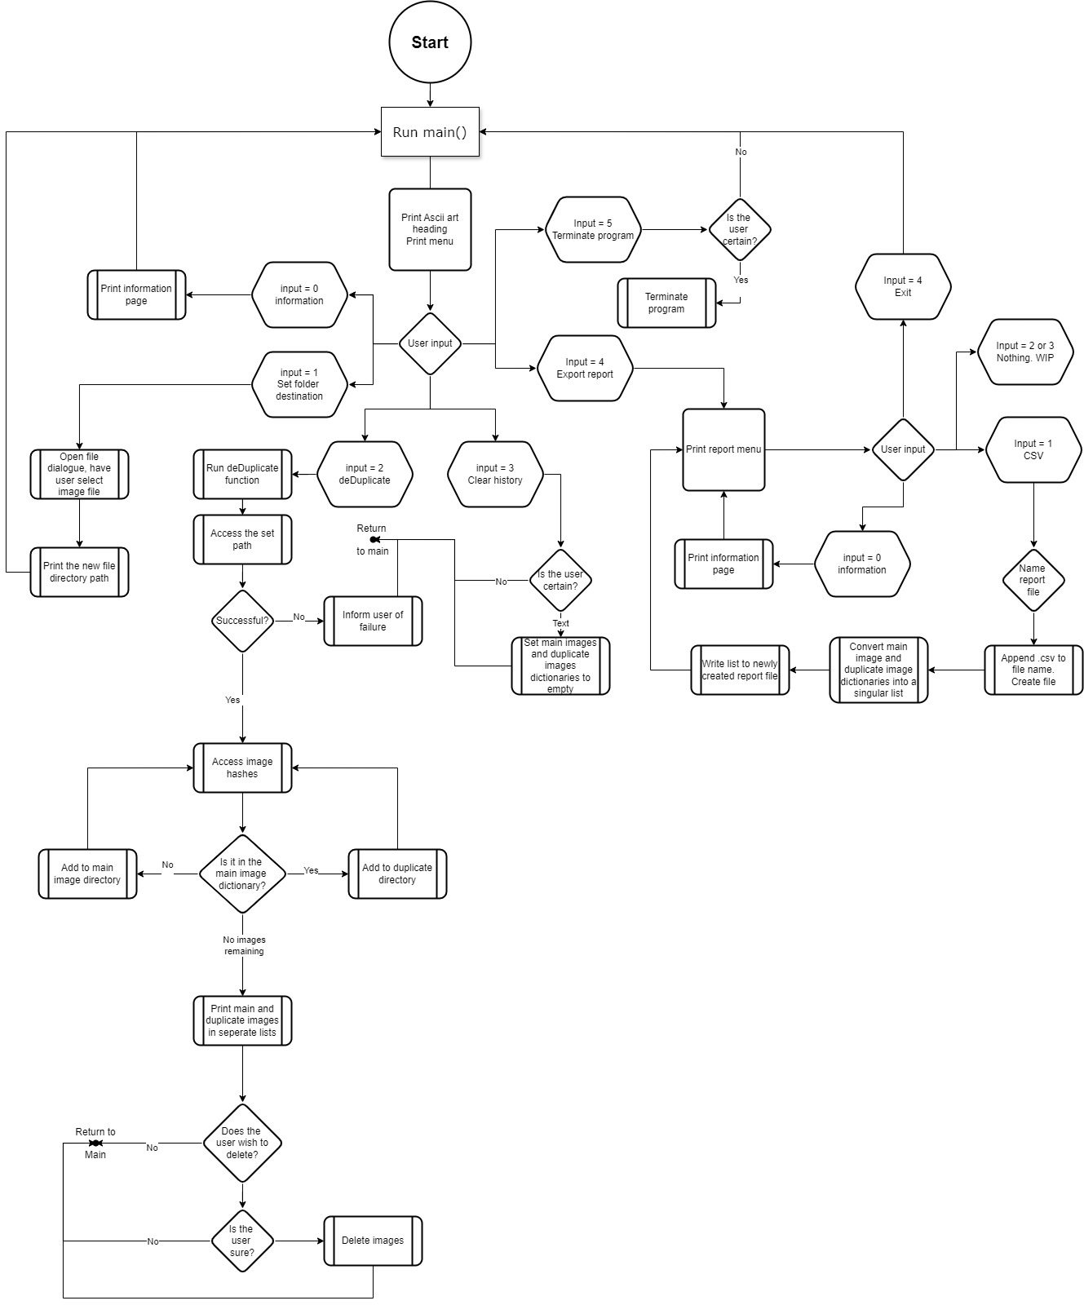
PYTHON CODE IMPLEMENTATION

Slide 20
TESTING

Slide 21

Thank you
Completing our final project wouldn't have been possible without the dedication, support, and hard work of this amazing group.
To our teammates in this bootcamp - It's been a pleasure working alongside all of you, you made these 13 weeks fly by!
To John -

